Slide 1

A piece of Cake (C# make)

Slide 2
For the next hour
What is Cake?
Why Cake?
How does Cake work?
How to “bake” a Cake?
Demo

Slide 3

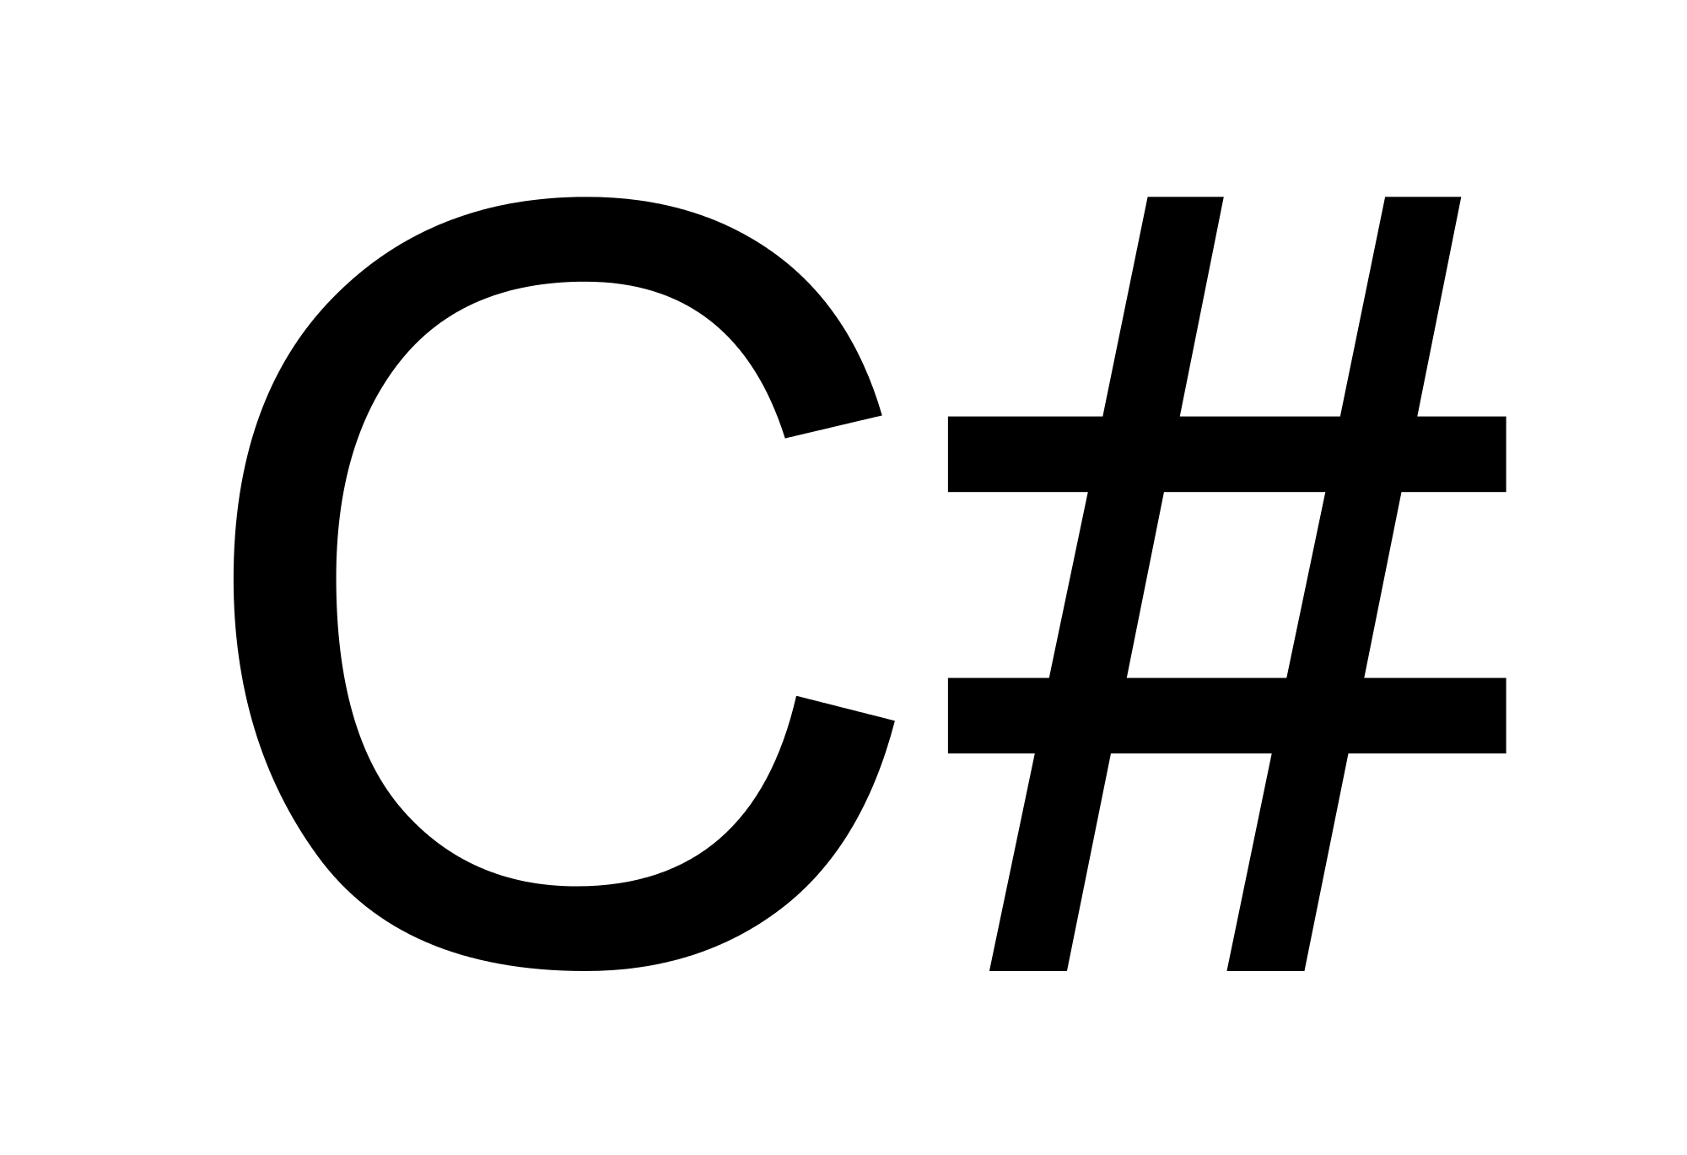
WHAT IS CAKE?
=
+
Make
Cake (C# Make) is free and open source cross-platform build automation system with a C# DSL for tasks such as compiling code, copying files and folders, running unit tests, compressing files and building NuGet packages.
from cakebuild.net
Build automation system
Uses Roslyn to run a C# DLS
OSS project since 2014
Part of the .NET foundation since 2016

Slide 4
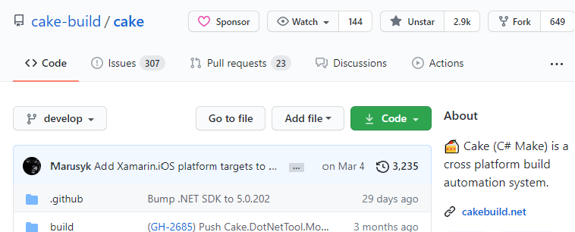
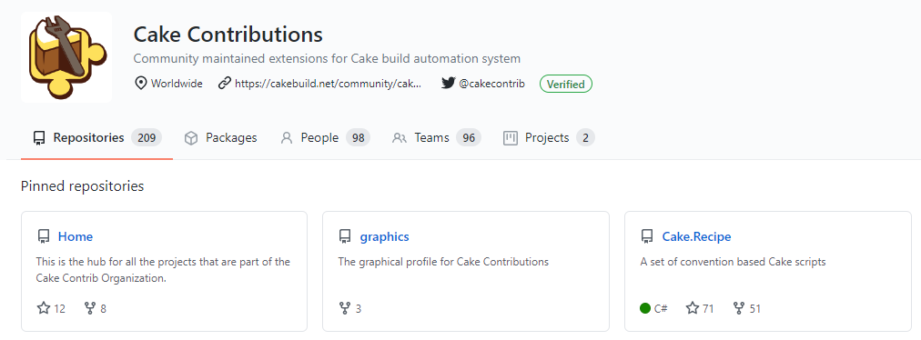
https://github.com/cake-build/cake
https://github.com/cake-contrib

Slide 5
Option 1: Ask somebody
• Error-prone process
• Is NOT 24/7 service
• After 6 months you cannot repeat everything
Option 2: Configure process on CI server
• Lock-in on CI’s definition language
• Configuration is not under version control system*
• There is no link between solution and build definition
Option 3: Use MSBuild/PowerShell
• Complex syntax
• Debugging process is a rocket science
• Limited set of features out of the box

Slide 6


WHY CAKE?
• Is not PowerShell
• Cake can use tools and add-ins as NuGet packages
• Cross platform / environment / CI / runtime
• IDE integration
• Version controlled

Slide 7
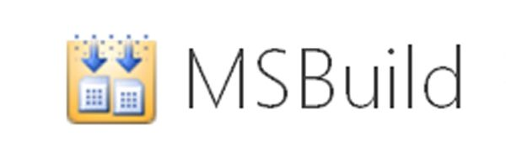

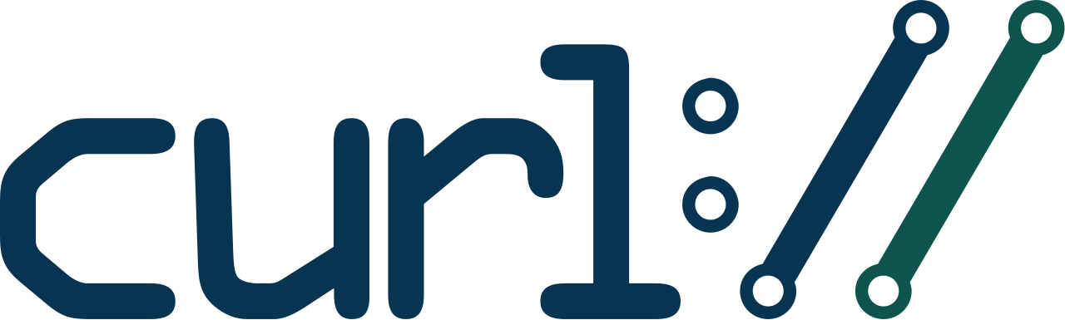




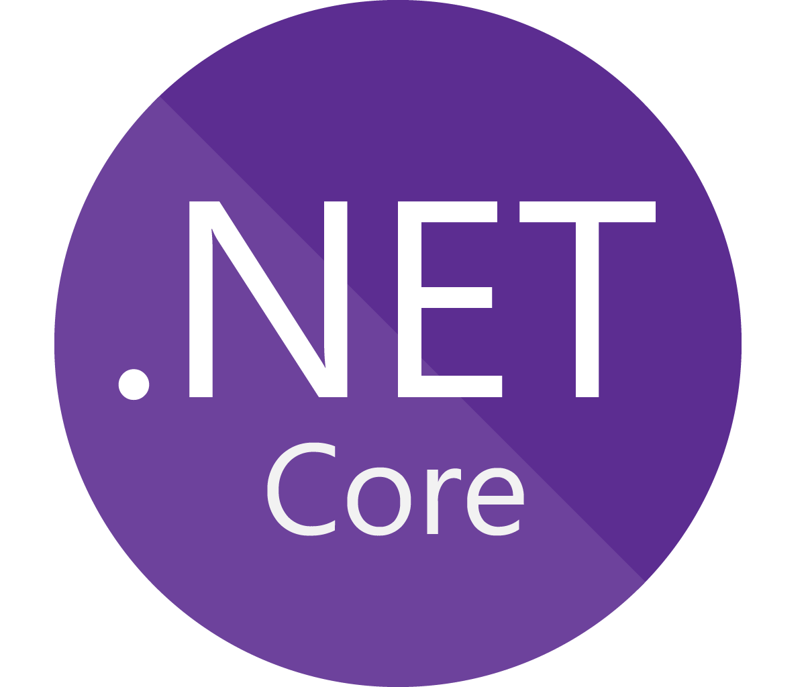


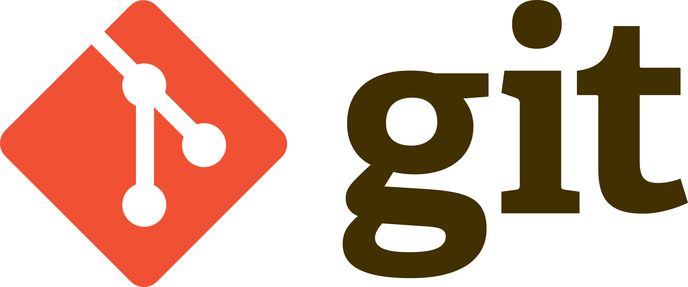


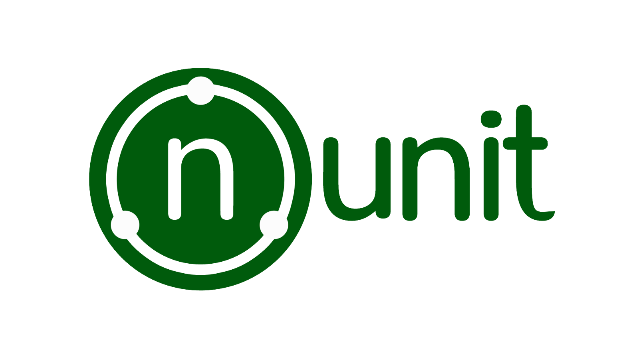
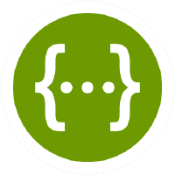

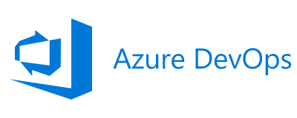
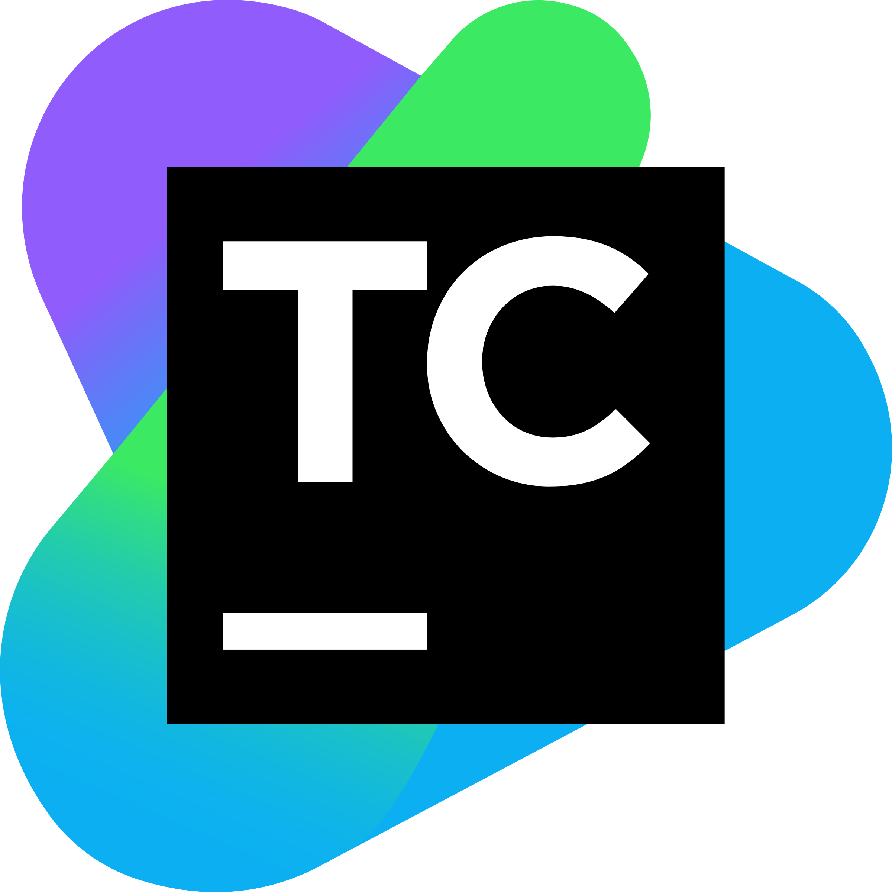
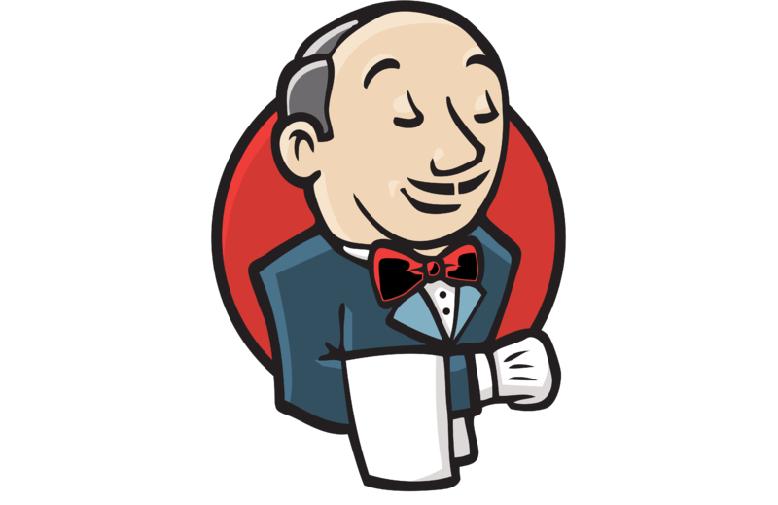





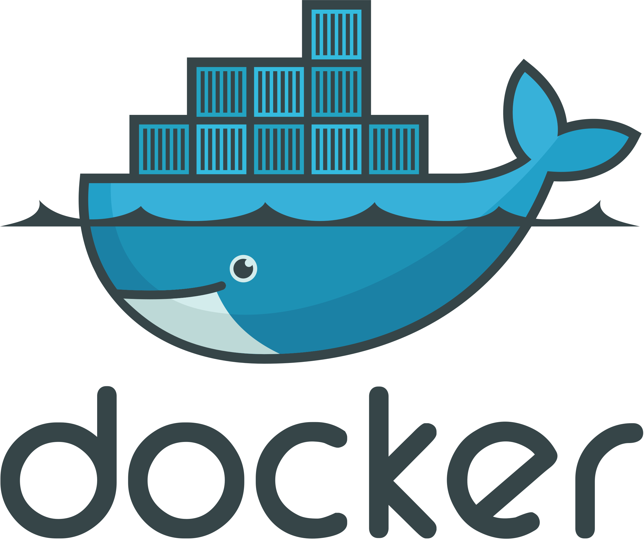
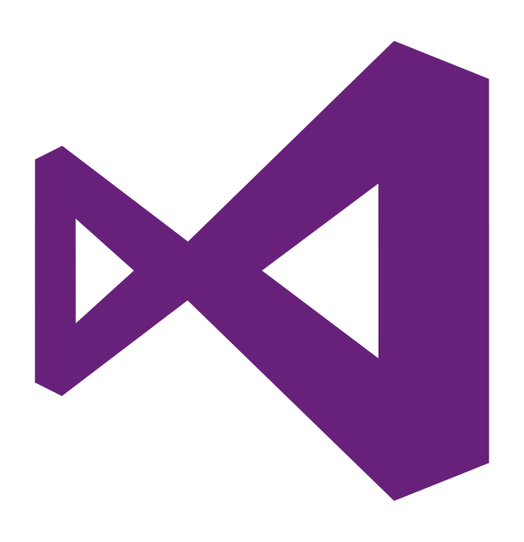
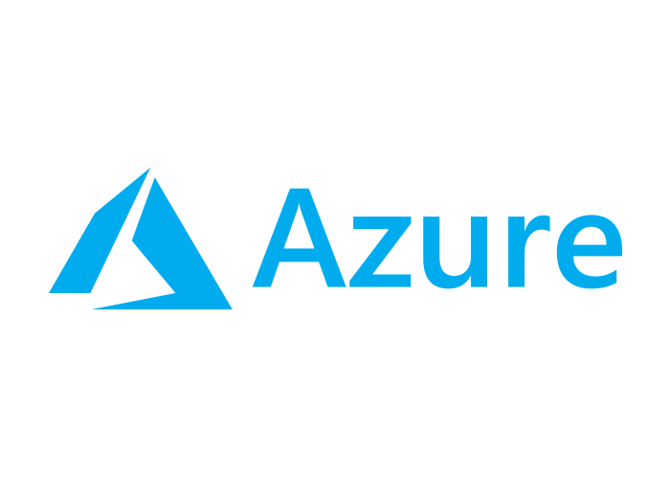




Slide 8
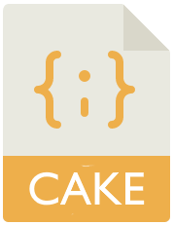

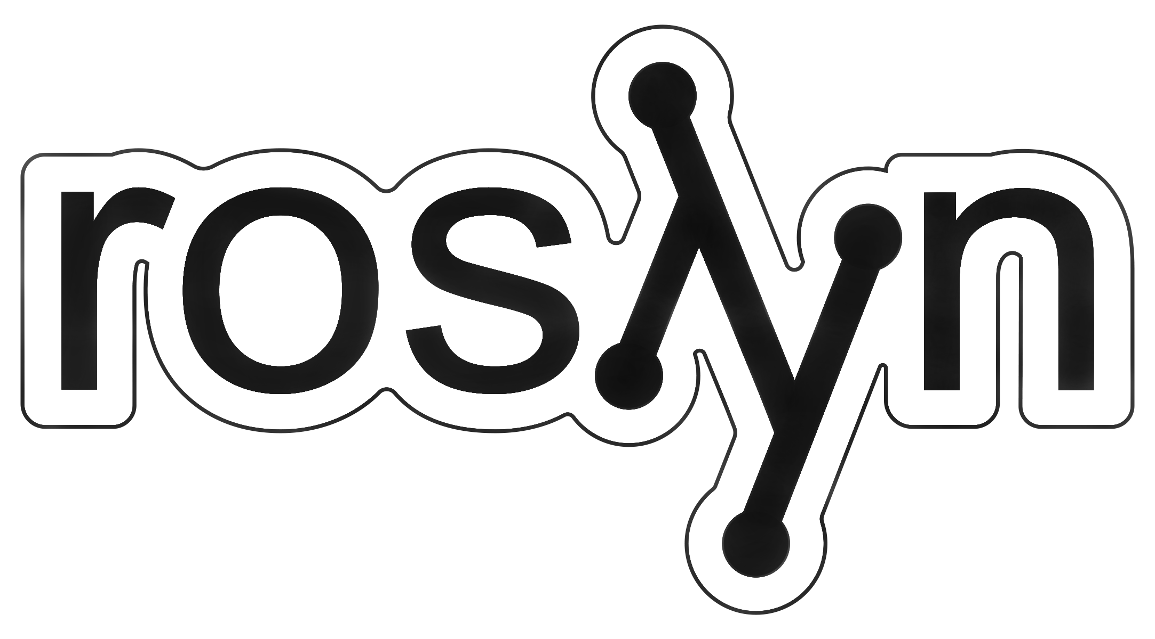


HOW DOES CAKE WORK?
Invoke target
nupkg
exe
dll
msi
…
Input
Cake file (C#)
Some kind of result
Input
Cake.exe
In-memory assembly
Configuration and arguments
Compile
Install packages
Script engine
Packages

Slide 9
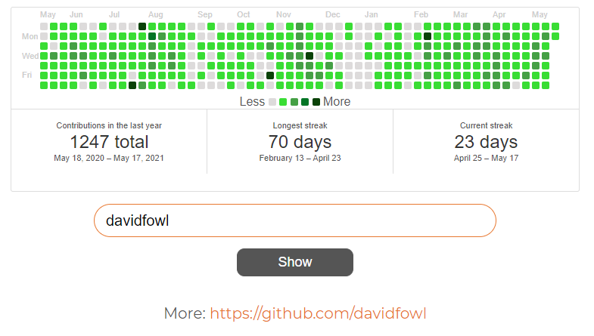
GitHub Calendar
Source: https://github.com/Marusyk/GitHubCalendar

Slide 10
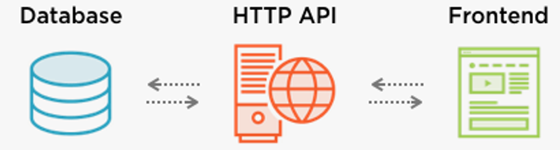

Architecture
.NET 5.0
Azure Web App

Slide 11
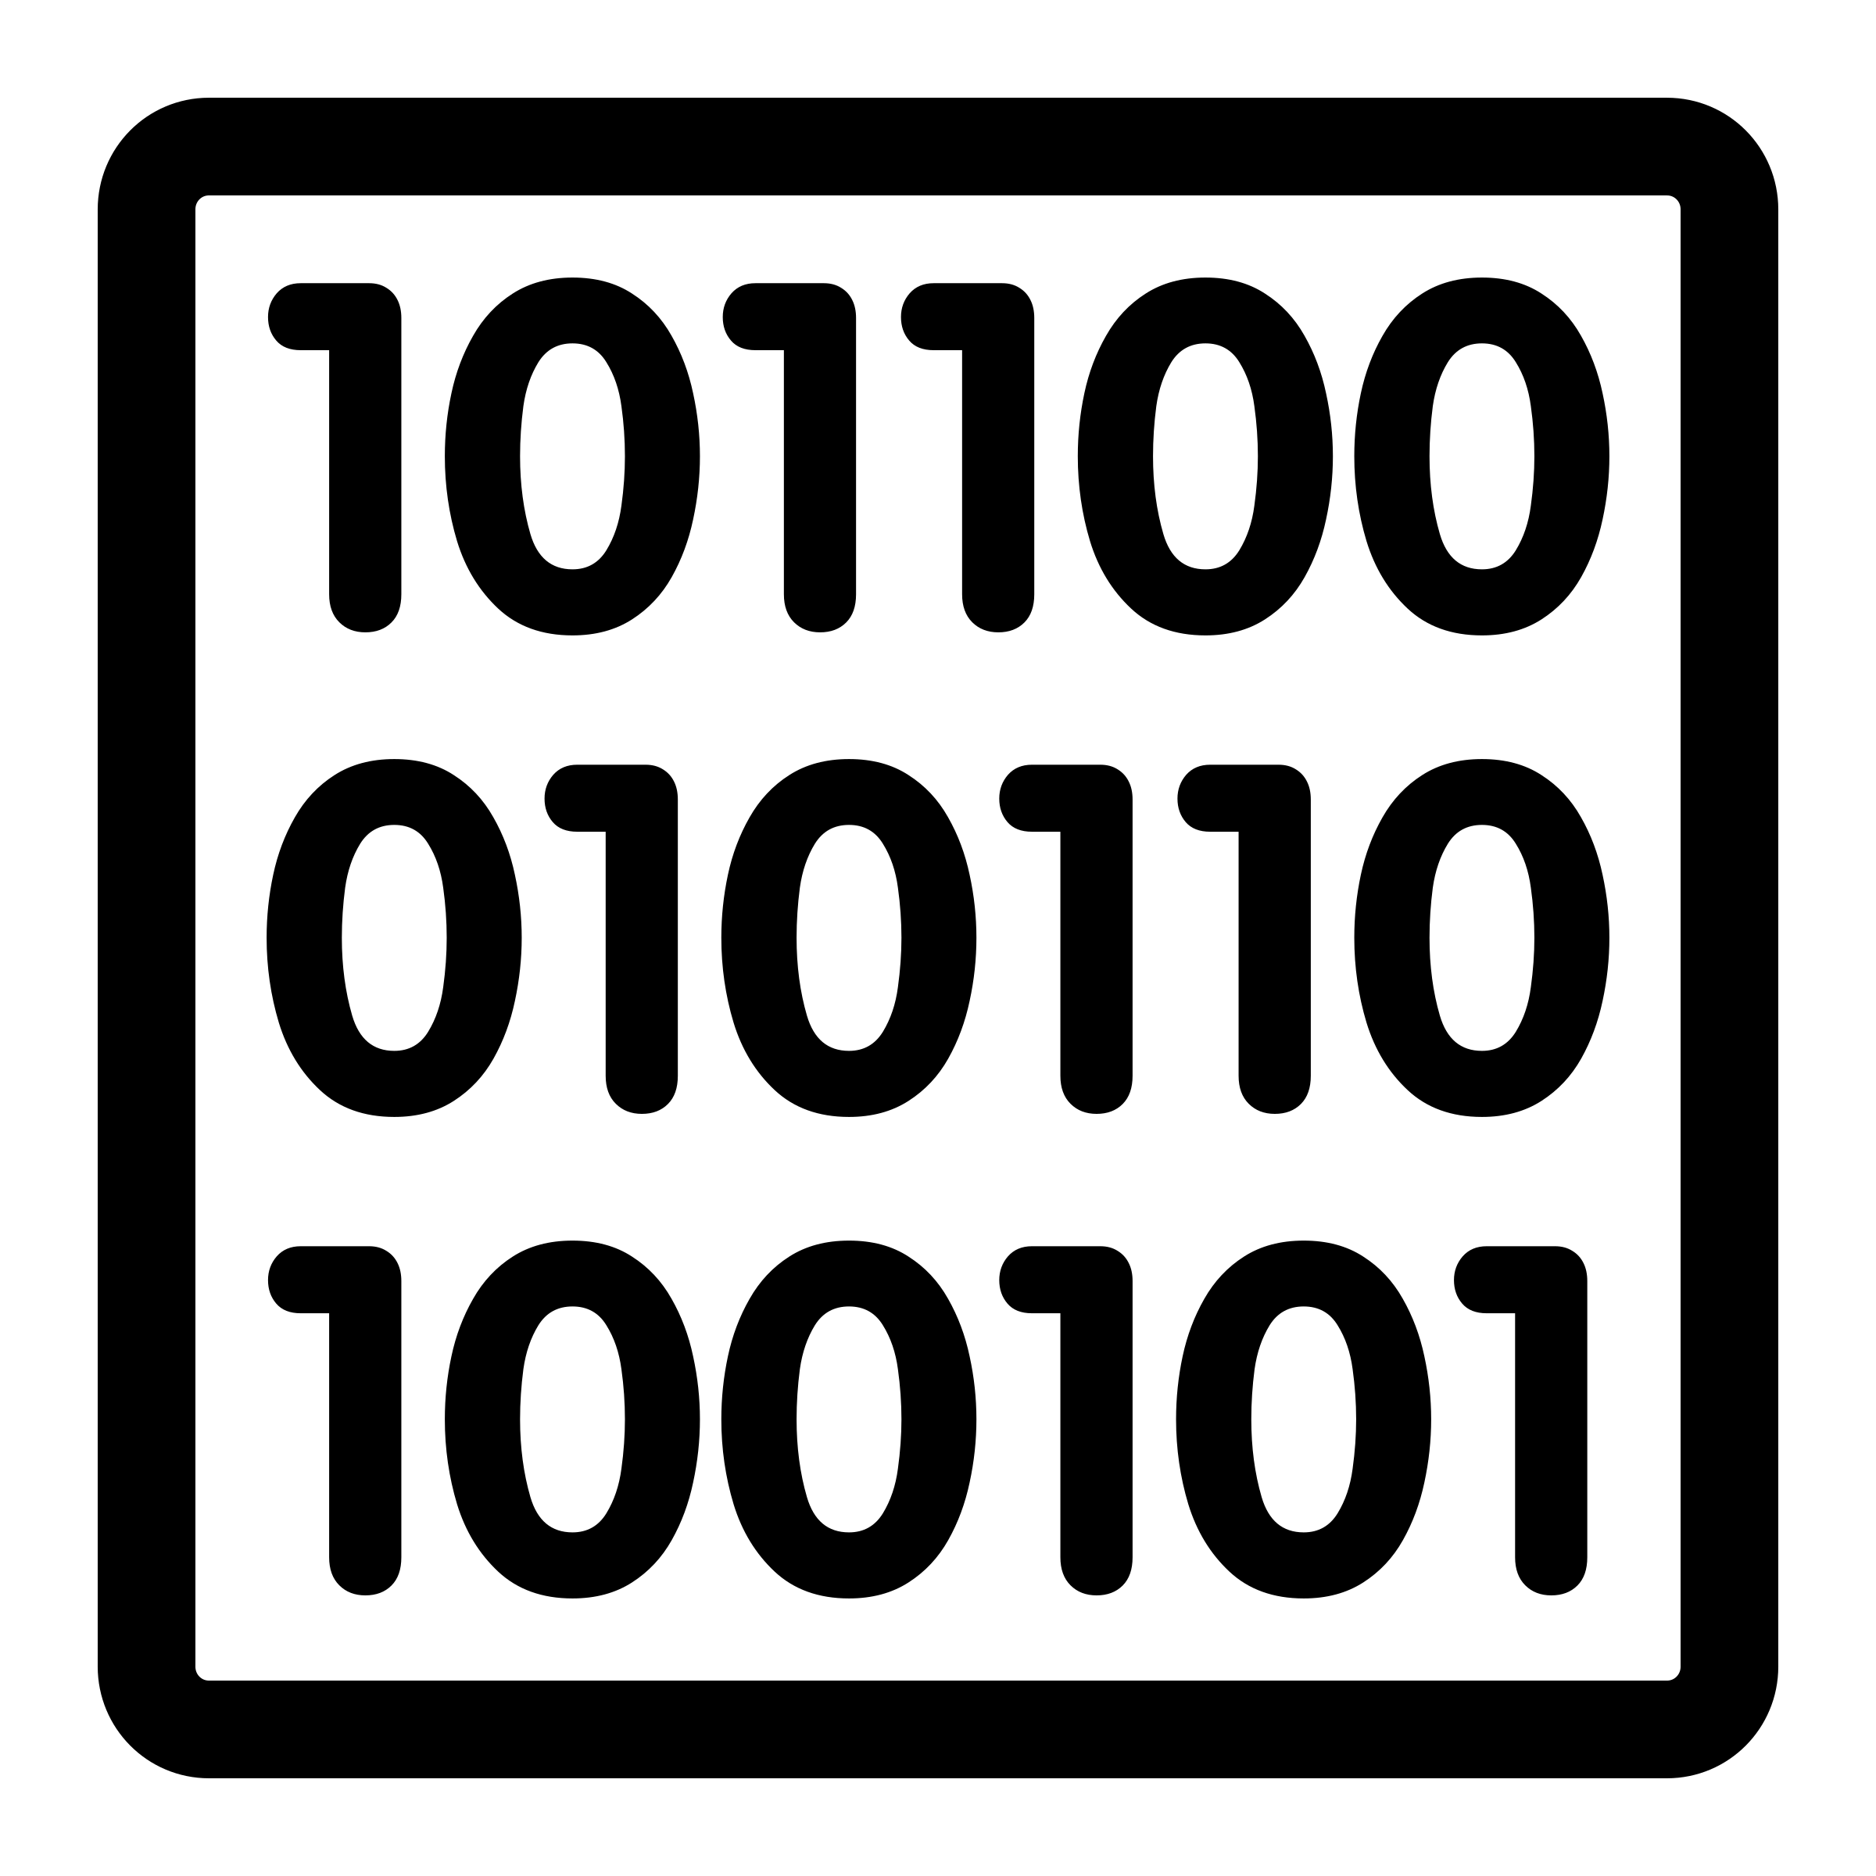



The Pipeline
Compile
Test
Package
Deploy
dotnet build
dotnet test
dotnet publish
kudu

Slide 12
HOW TO “BAKE” A CAKE?
build.cake
Actual build script
Cake.Tool
Cake runtime
// Run from root of your project
// Only required to be run once
dotnet new tool-manifest
dotnet tool install Cake.Tool
dotnet tool restore
dotnet cake --info

Slide 13

The demo

Slide 14

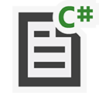

Summary
Compile
Test
Package
Deploy

Slide 15
Summary
It is C#
Unify your build process
Versioning the build script with the source code of the application
Being able to run a build where you want
Coming with almost all tools, addins you need for your build process
Open source and great responsive community
No need to version binaries
Syntax highlighting and debug mode

Slide 16





Thanks!
Q & A
roman.marusyk@globallogic.com
@MarusykRoman
Marusyk
rmarusyk

